Slide 1
Linear Algebra
Lecture 10

Slide 2
Systems of
Linear Equations

Slide 3
The Matrix
of a Linear
Transformations

Slide 4
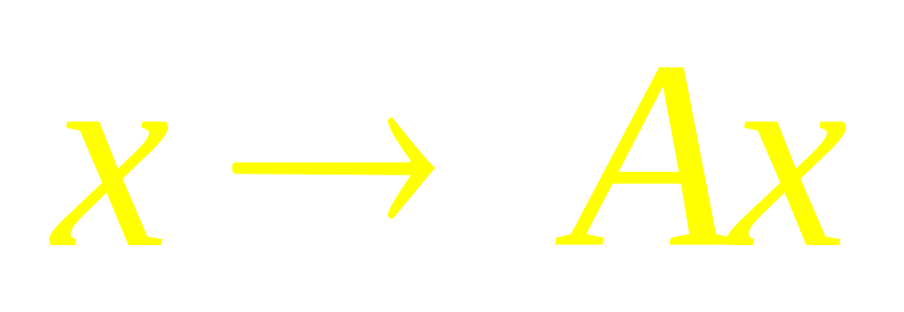
Every Linear Transformation from R^{n} to R^{m} is actually a matrix Transformation

Slide 5
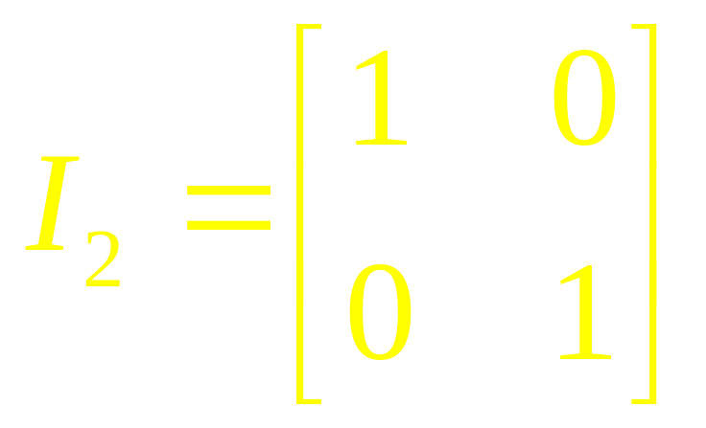
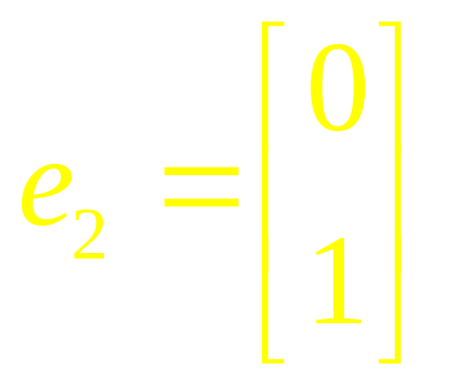
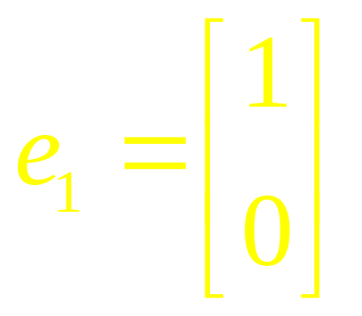
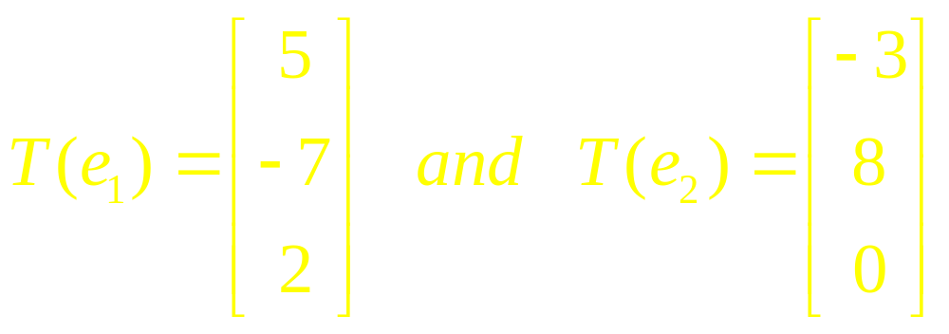
Example 1

Slide 6
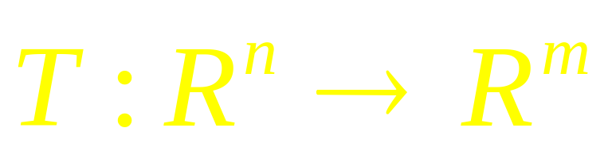
Theorem
Let
be a linear transformation. Then there exist a unique matrix A such that T(x)=Ax for all x in R^{n}.

Slide 7
Example 2
Find the standard matrix A for the dilation transformation T(x)=3x for all x in R²

Slide 8
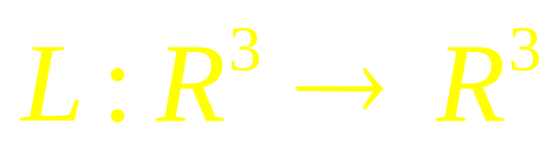
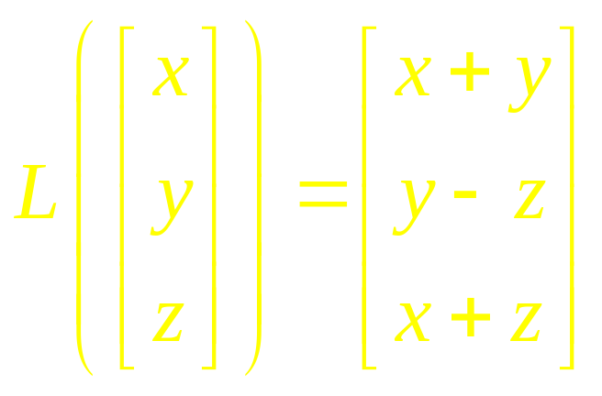
Example 3
Let
be the linear operator defined by
Find the standard matrix representing L and verify L(x)=Ax

Slide 9
Example 4

Slide 10
Geometric LT of R²
Examples 2 and 3 illustrate LT that are described geometrically.
Tables 1 – 4 in the book illustrate
other common geometric linear
transformations of the plane.
Because the transformations are linear,
they are determined completely by
what they do to the columns of I₂

Slide 11
Instead of showing only the images of e₁ and e₂, the tables show what a transformation does to the unit square

Slide 12
Other transformations can be constructed from those listed in Tables 1 – 4 by applying one transformation after another

Slide 13
Example 5

Slide 14
Definitions

Slide 15
Example 6

Slide 16
Theorems

Slide 17
Example 7

Slide 18
Linear Algebra
Lecture 10

